Slide 1
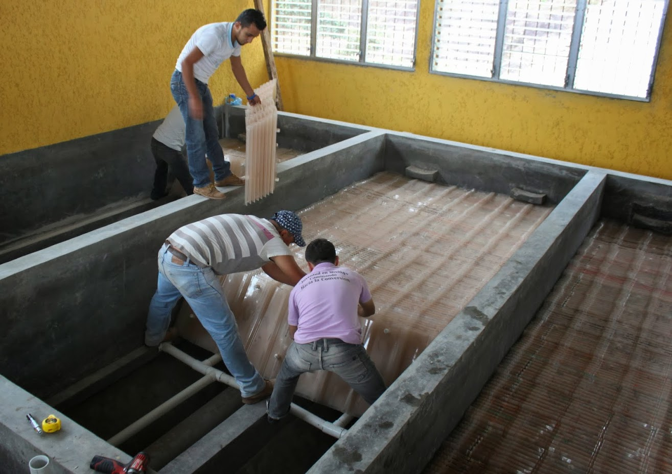
Clarification

Slide 2
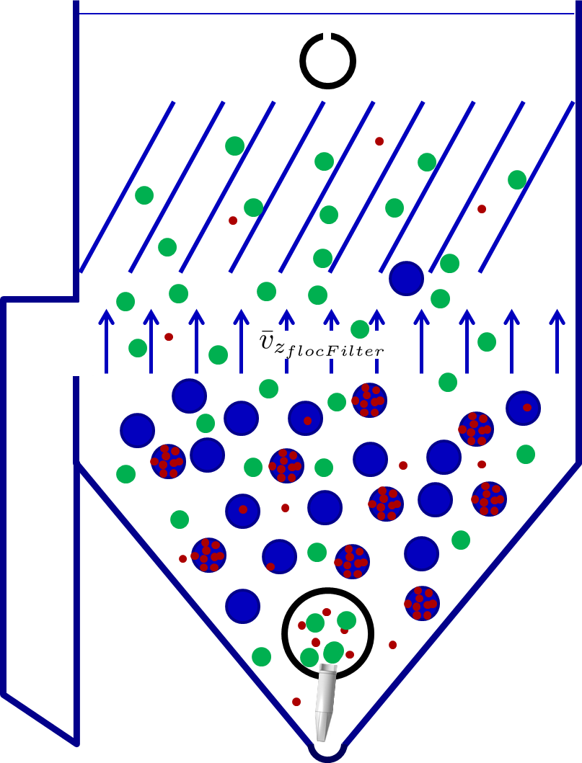
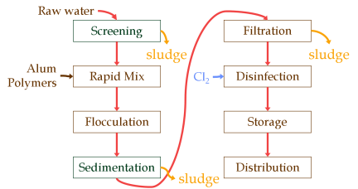
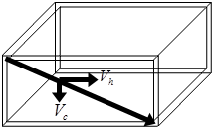
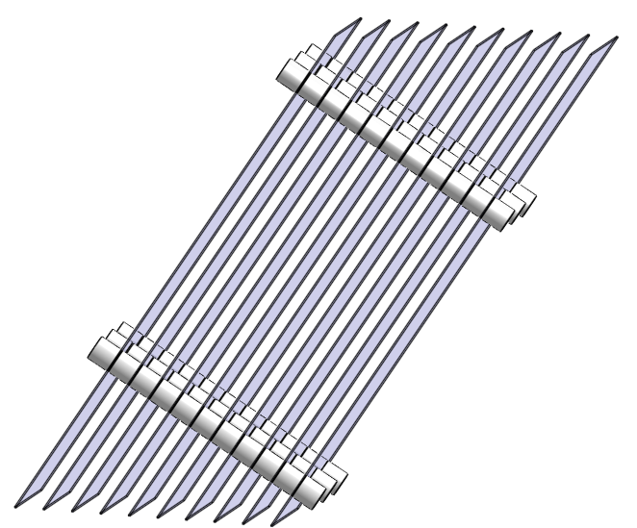
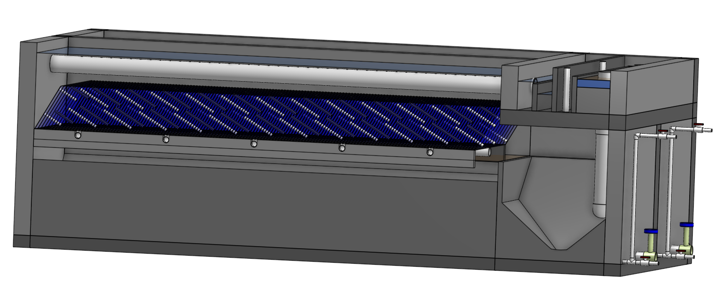
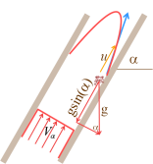
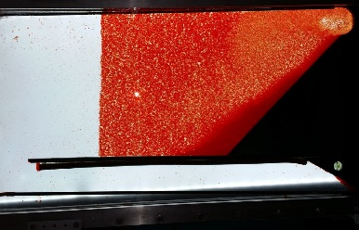
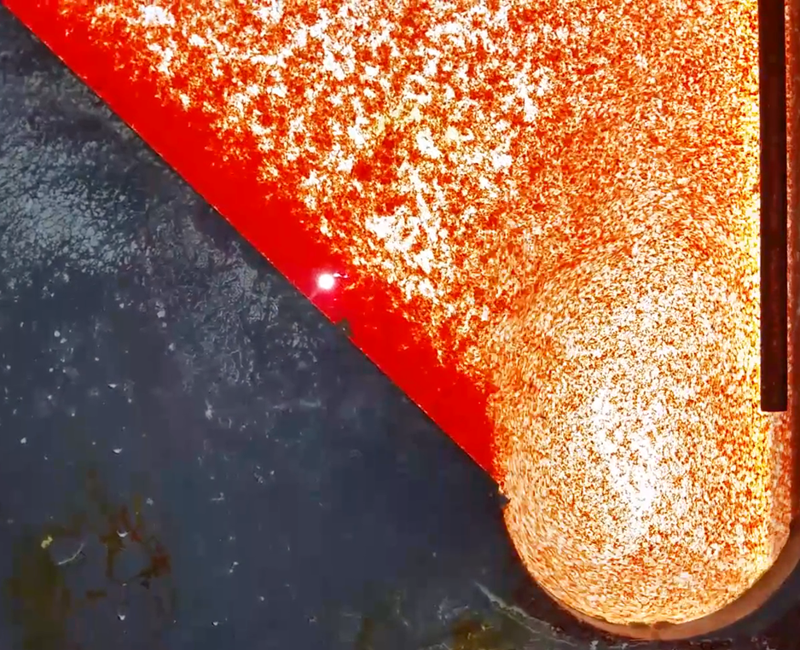
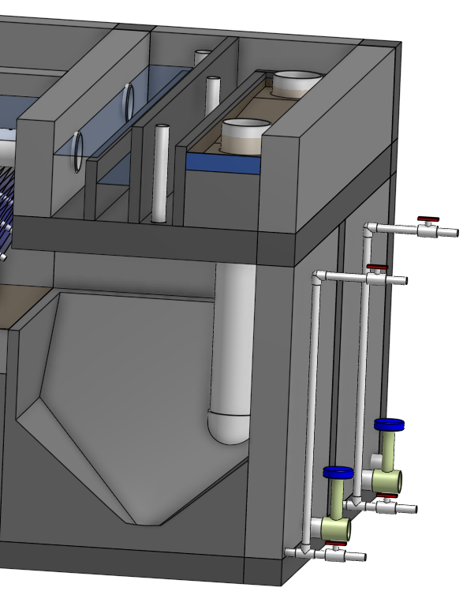
Topics
Introduction
Floc-filter/Sed
Floc filter
Floc resuspension
Floc Hoppers
Capture velocity
Plate settlers
Floc rollup

Slide 3
Conventional Surface Water Treatment
Raw water
Screening, grit removal, flow measurement
Rapid Sand Dual
Media Filtration
sludge
Backwash water
Coagulant
Mechanical Rapid Mix
Cl₂
Disinfection
Mechanical Flocculation
Storage
Sedimentation
Distribution
sludge

Slide 4
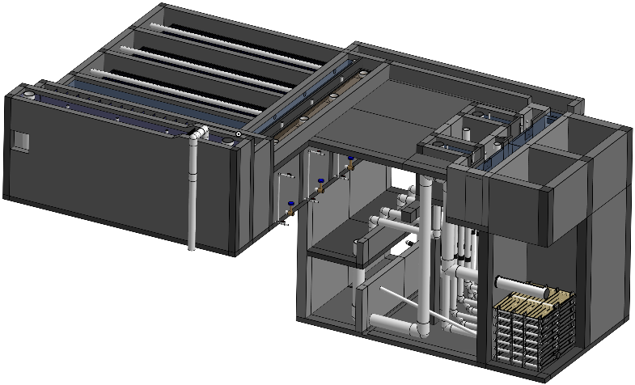
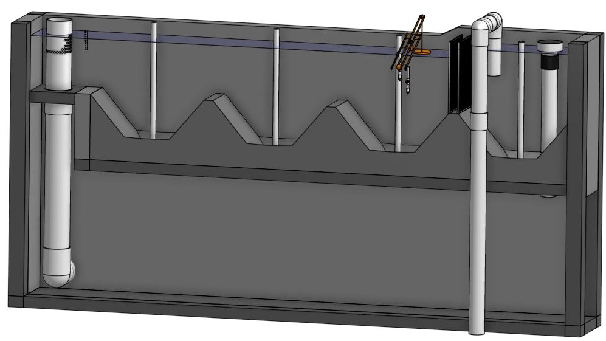
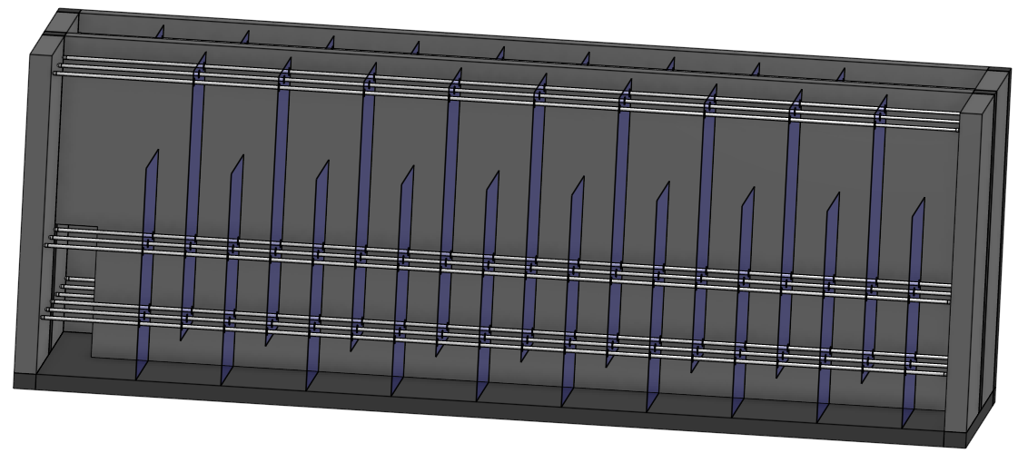
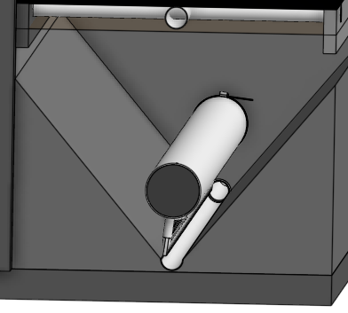
AguaClara Surface Water Treatment
Raw water
Backwash recycle proposed
Screening, grit removal, flow measurement
Stacked Rapid
Sand Filtration
Coagulant
sludge
Backwash water
Cl₂
Hydraulic
Flocculation
Storage
Floc Filter
Distribution
Floc Hopper
Plate Settlers
sludge

Slide 5




Floc-filter/Sed
Dump poorly flocculated water channel
Exit Weir that controls water levels all the way upstream to the next free fall (LFOM!)
To filters
floc filter
Notes:
Exercise: Tell the story of the journey of a large floc, a small floc, a rouge loner clay particle, and of a water molecule as each travels through this Floc-filter/Sed.
How do plate settlers work

Slide 6
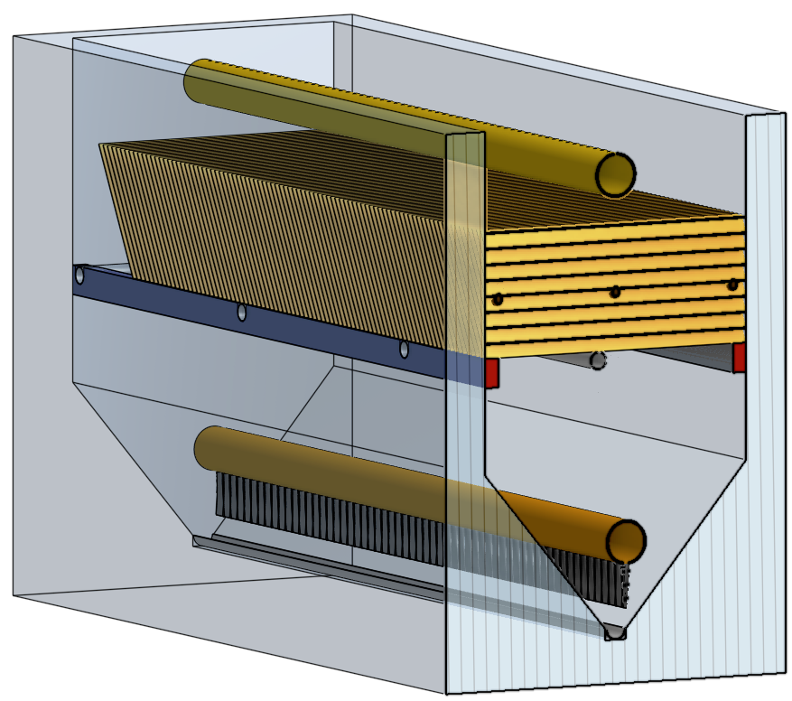
Elements of the Floc-filter/Sed
Plate settler modules that can be removed by an operator
Effluent manifold
Plate settlers
Sloped surfaces so that no sludge can accumulate
Diffusers that create a line jet
Influent manifold
Jet reverser

Slide 7
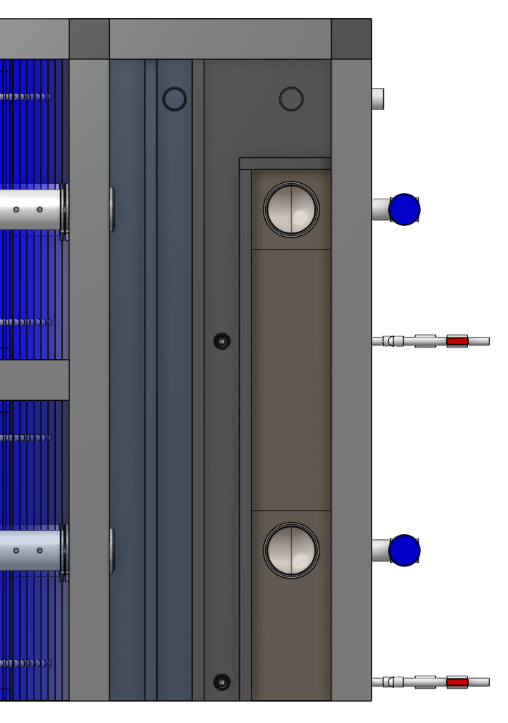
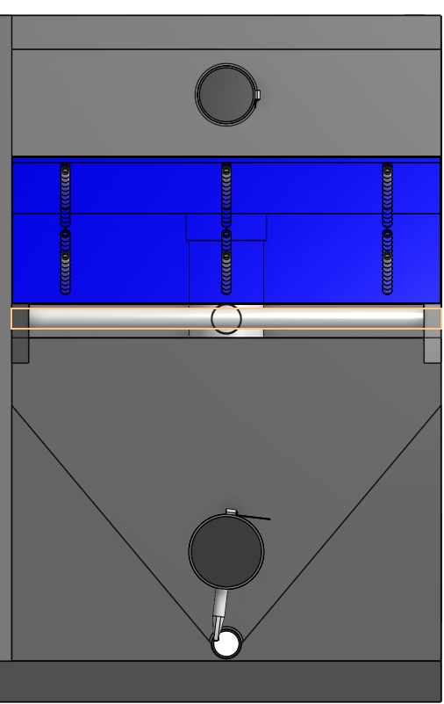
Floc-filter/Sed
Top view of channels
How do the flocs get into the floc hopper?
What controls the water level?
How could the operator see what is in the floc hopper?
End view
Plate settlers
floc filter
floc hopper

Slide 8
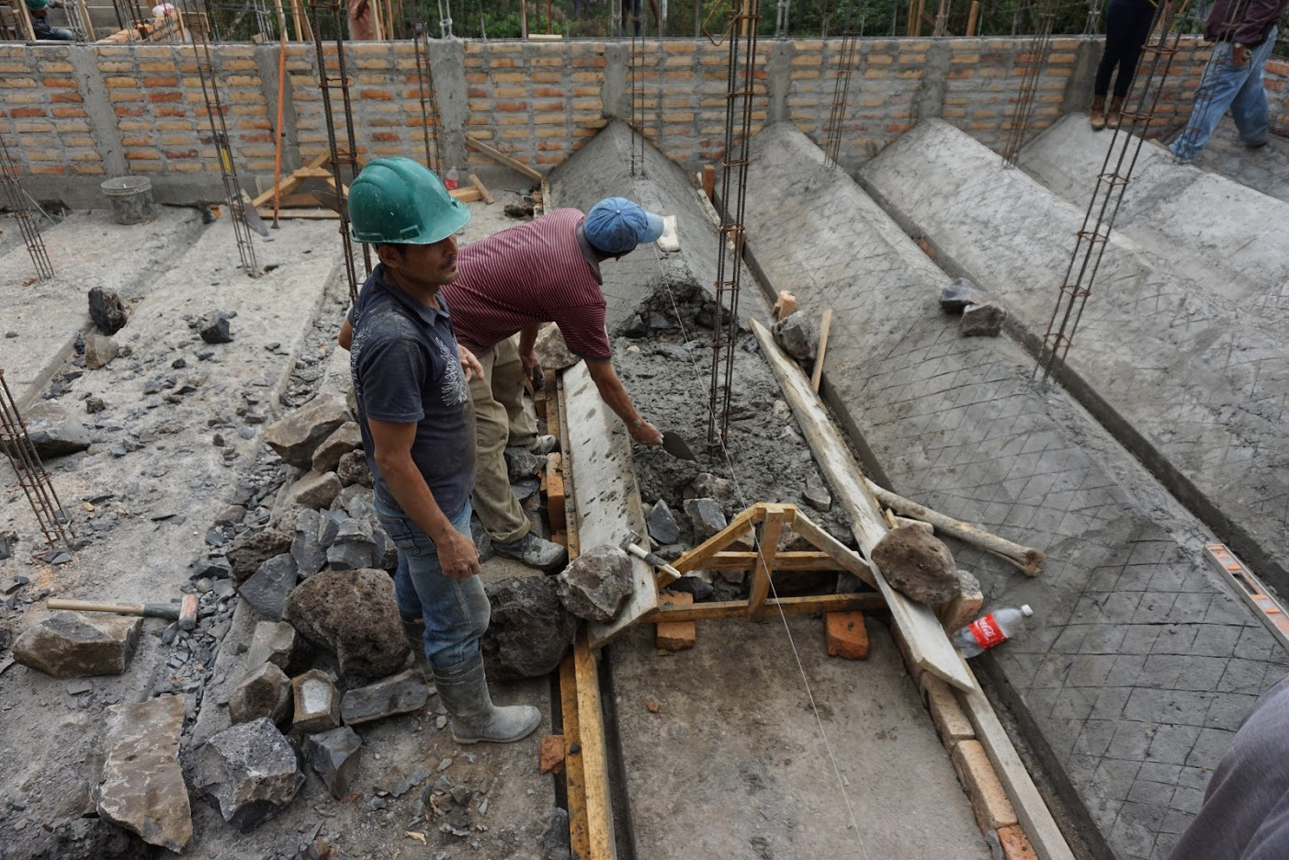

Slide 9
We need your help to Name the Floc-filter/Sed!
We’d like a name that describes what it does
Self-cleaning with floc filter and plate settlers
Much more than a sedimentation tank
I’m calling it a Floc-filter/Sed in these notes temporarily

Slide 10
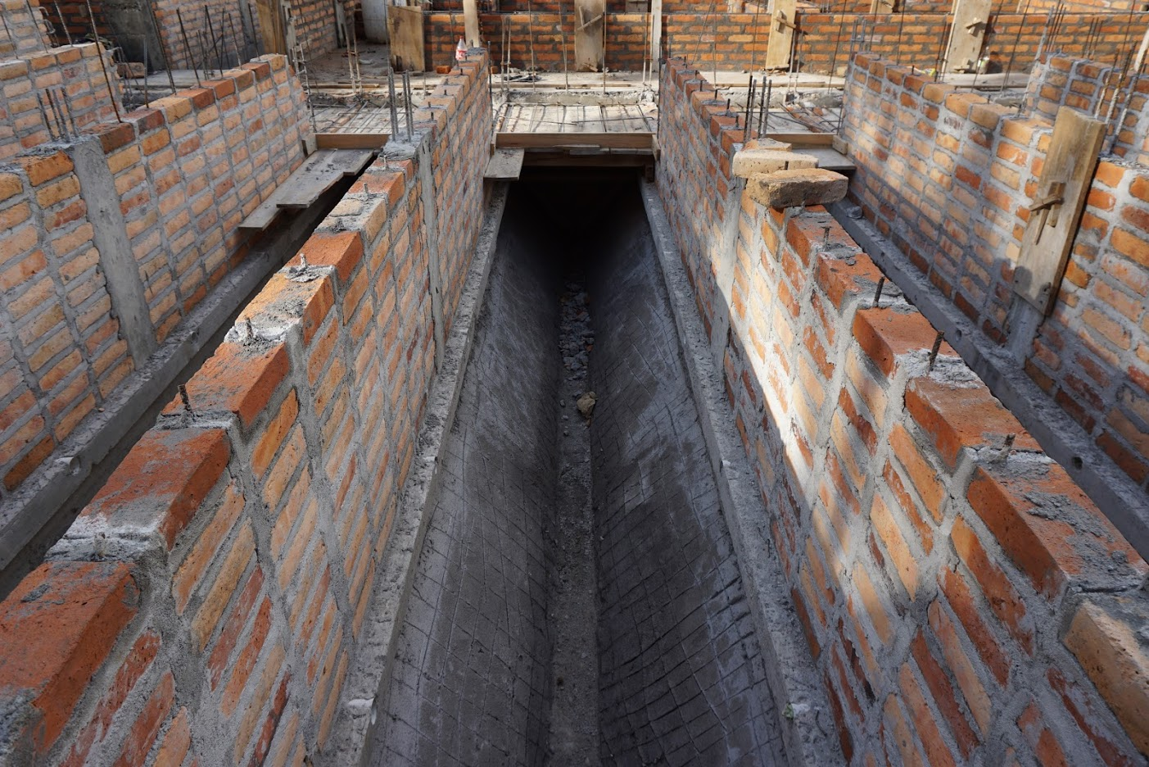

Slide 11
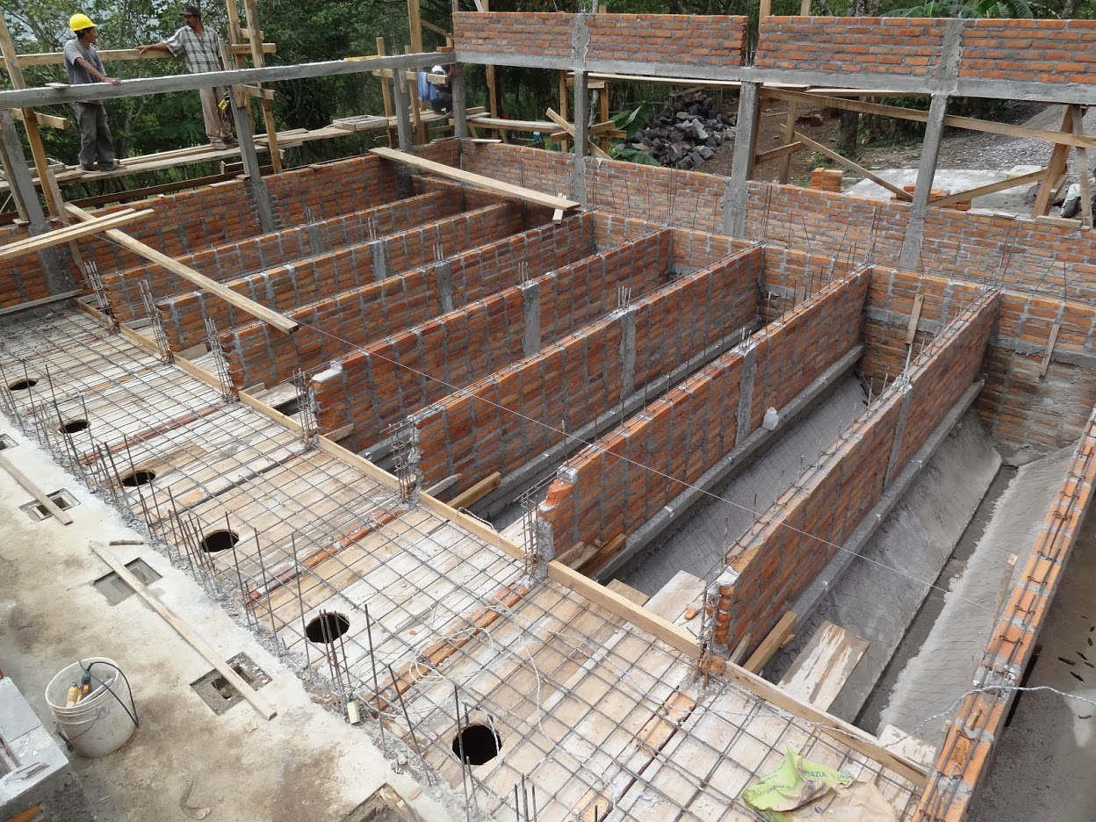

Slide 12
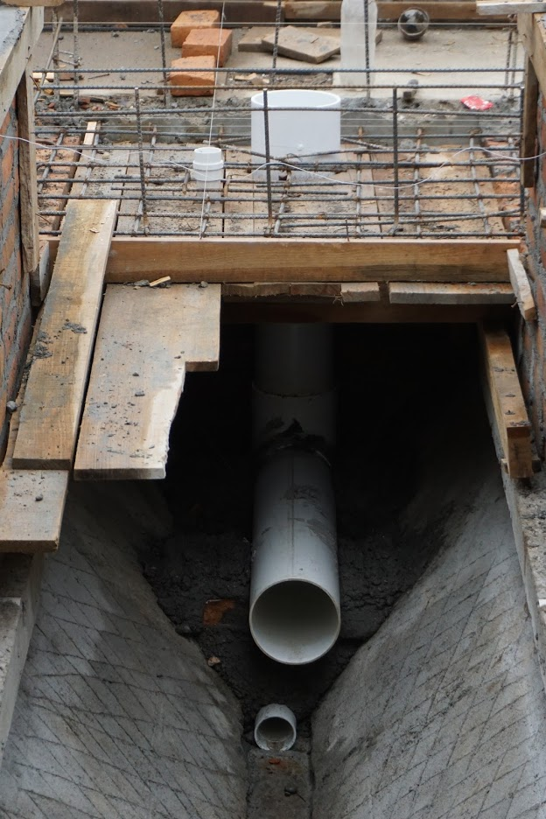
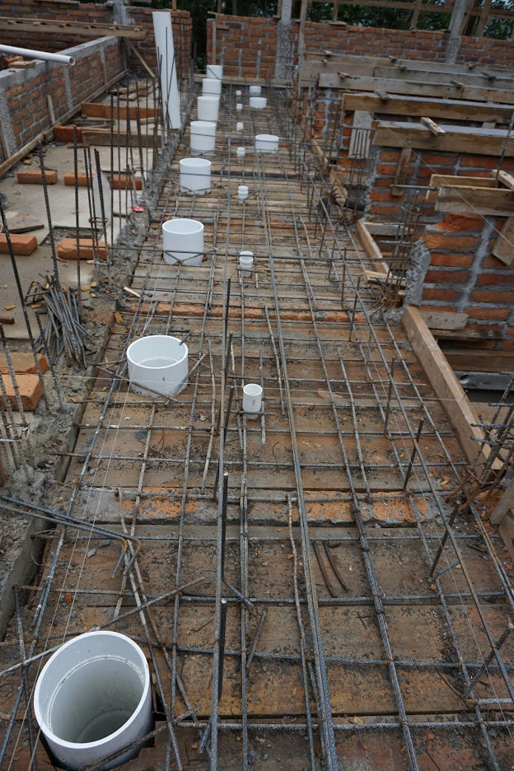

Slide 13
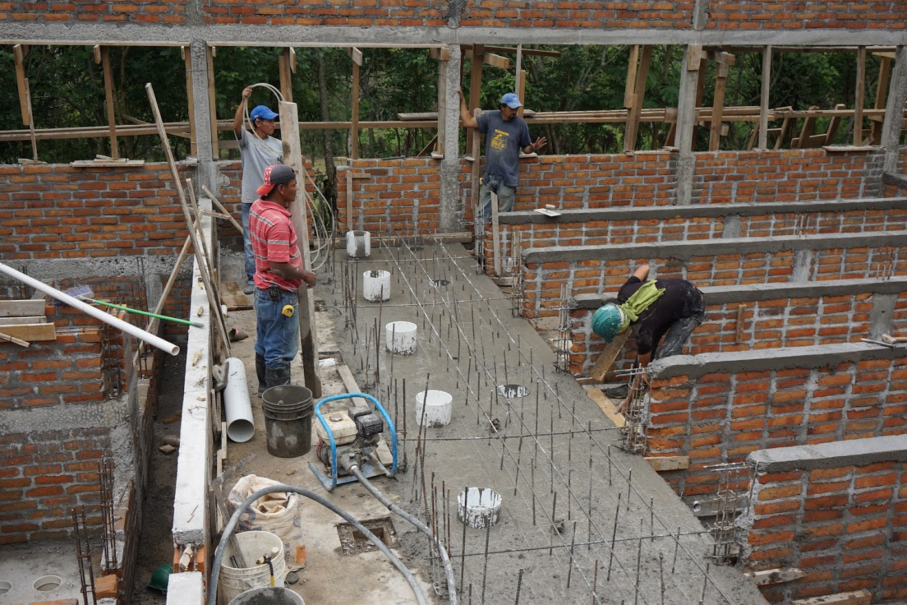

Slide 14
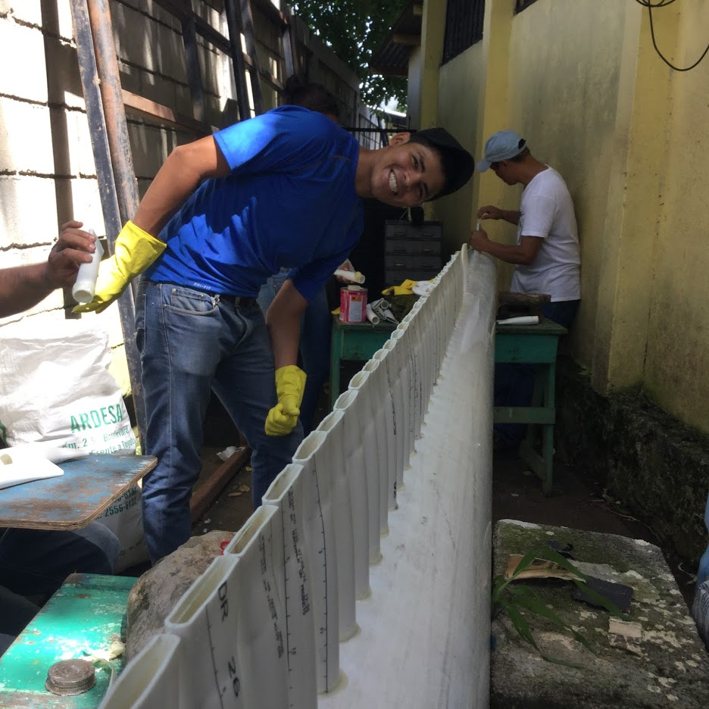

Slide 15
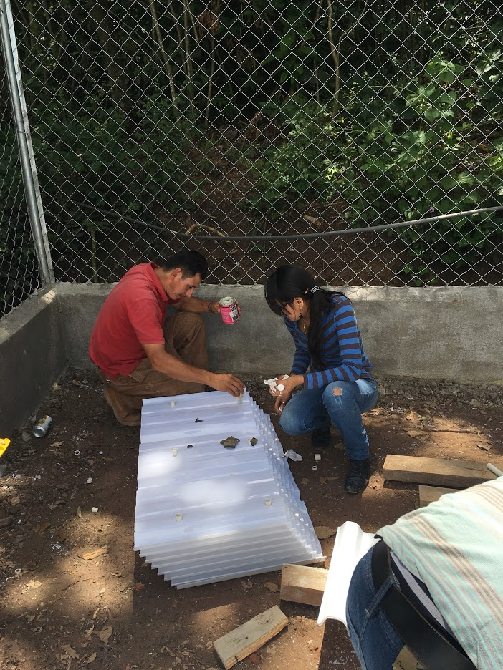
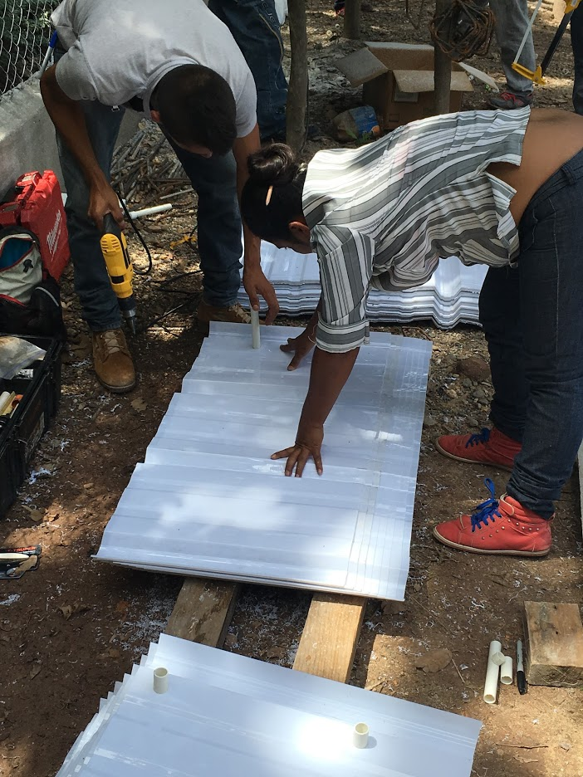

Slide 16
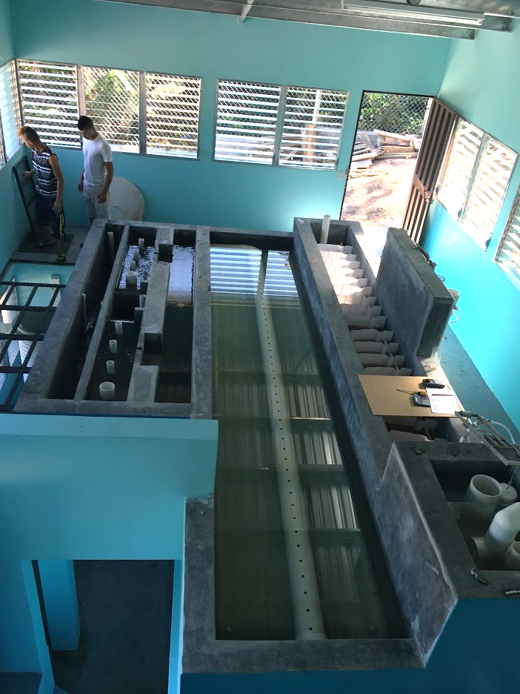
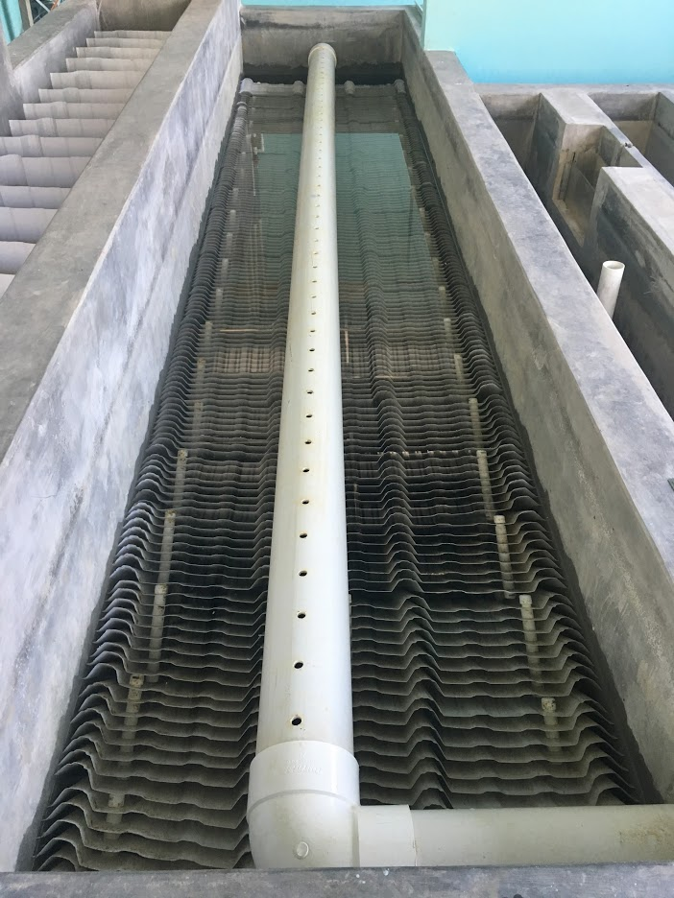

Slide 17
Flocculation SWOT (strength, weakness opportunities, threat) for SWOT (safe water on tap)
Strength
Rapidly reduces the primary particle concentration
Produces flocs that can be captured by sedimentation or filtration
Weakness
Always leaves a significant number of primary particles
Further increases in expenditure of energy and flocculator volume don’t produce significant improvement

Slide 18
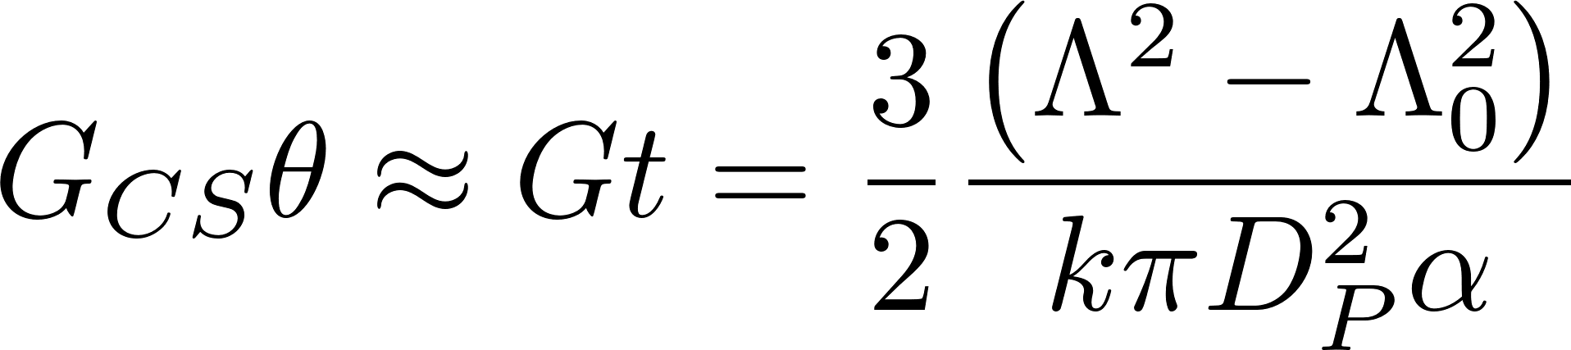
Flocculation is unable to aggregate all primary particles
Flocs are useless in flocculators
No successful collisions between primary particles and flocs
Notes:
I haven’t been able to find literature that demonstrates this effect.
Likely that the water contained within a floc simply rotates with the floc and that no new water enters the floc in a shear flow.

Slide 19
Four sizes/types of Floc
New flocs in the floc filter
Full flocs in the floc filter
Primary particles and flocs too small to be captured by the plate settlers
Flocs that settle fast enough to be captured by the plate settlers but not fast enough to stay in the floc filter

Slide 20
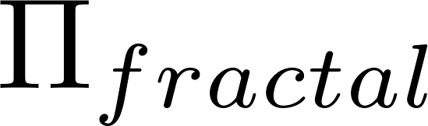
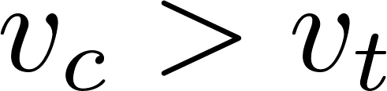
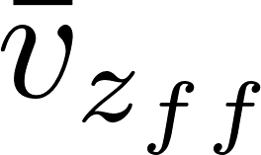
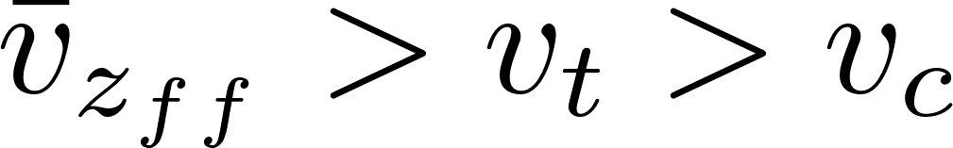
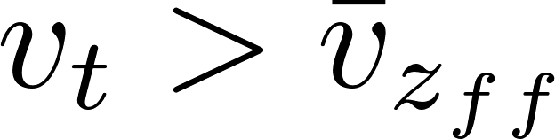
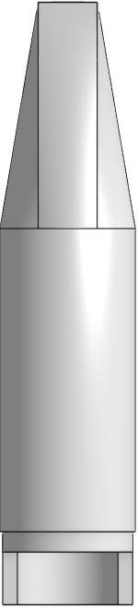
Floc Filter, Plate Settler, Floc Hopper
Effluent manifold
Plate Settlers
 | Terminal Velocity
 |  | 2
 |  | 2
 |  | 2
 |  | >2
Floc Filter
Floc Hopper
Inlet (from flocculator)
Notes:
Story
Big green flocs from flocculator form blue floc filters in the plate settler
Red flocs

Slide 21
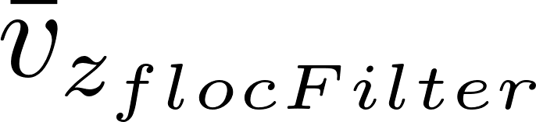
Floc Filter
 | Terminal Velocity
 |  | 2
 |  | 2
 |  | 2
 |  | >2
Floc filter is a high concentration of a fluidized bed of flocs that in a uniform upward flow
In floc filters small particles flow through large flocs (held in place by gravity) where they can collide with small particles that are part of the floc
Flocs are filters!
Notes:
Story
Big green flocs from flocculator form blue floc filters in the plate settler
Red flocs

Slide 22
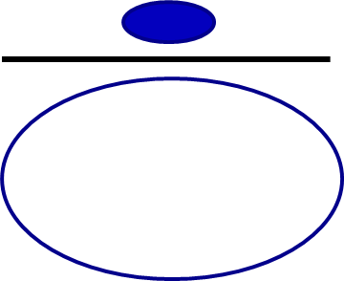
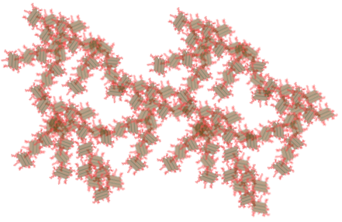
Flocs have a finite capacity to capture incoming particles
The fraction of the projected area flow that enters the floc, , is a function of the floc porosity (or fractal dimension)
No boundary layer preventing particles from entering the floc!
We are trying to figure out how to
Preferentially waste flocs that are full
Increase the concentration of flocs that have a low fractal dimension
I’m stuffed (my fractal dimension is too big and my porosity is too small)
I’m getting full

Slide 23
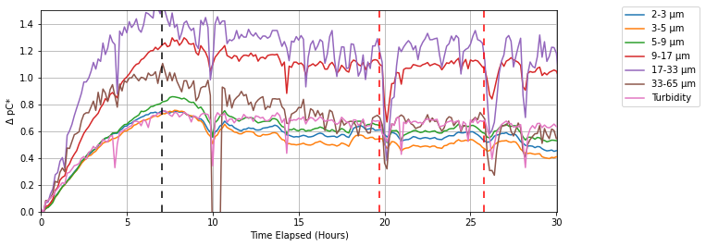
Floc filter performance deteriorates after the floc blanket begins wasting to the floc hopper!
Floc weir begins to overflow
Too many blue flocs with filtering capacity are being wasted!
Need to invent a way to selectively waste full flocs
Notes:
This is how we turn data into insights. We search for the simplest hypotheses that would be consistent with the observations.

Slide 24
Plate Settler
 | Terminal Velocity
 |  | 2
 |  | 2
 |  | 2
 |  | >2
Flocs aggregate as they slide down the plate!
Notes:
Story
Big green flocs from flocculator form blue floc filters in the plate settler
Red flocs

Slide 25

Flocs tumble down the plate settlers and grow larger
This creates the large flocs that can settle fast enough to stay in the floc filter from the flocs created by the flocculator
As big flocs fall from the plate settlers they break if they are bigger than the size set by the bond strength and gravity
If this aggregation weren’t happening there wouldn’t be any way for flocs to exit the plate settler!

Slide 26
Plate Settler Feeds Floc Filter
 | Terminal Velocity
 |  | 2
 |  | 2
 |  | 2
 |  | >2
Flocs in free fall have a maximum size!
The maximum size of flocs in the floc filter is set by gravity
Notes:
Story
Big green flocs from flocculator form blue floc filters in the plate settler
Red flocs

Slide 27
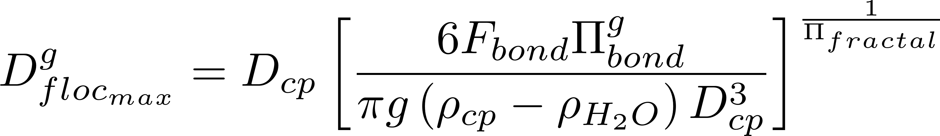
Floc maximum size based on each hemisphere trying to rotate
Drag
Each half of the floc experiences drag that tends to cause that half of the floc to rotate
Buoyancy is at 3/8 r
Drag is at greater distance from center of sphere.
Result is torque that puts lower floc bond in tension.
Buoyancy
Notes:
https://en.wikipedia.org/wiki/List_of_centroids
Centroid of hemisphere is at 3/8 r

Slide 28
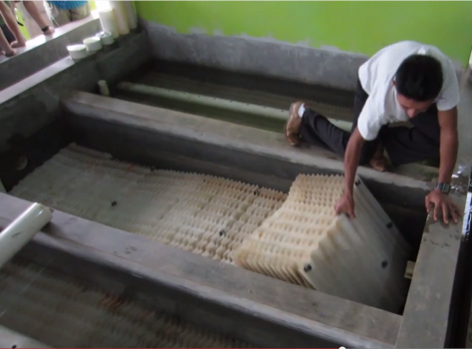
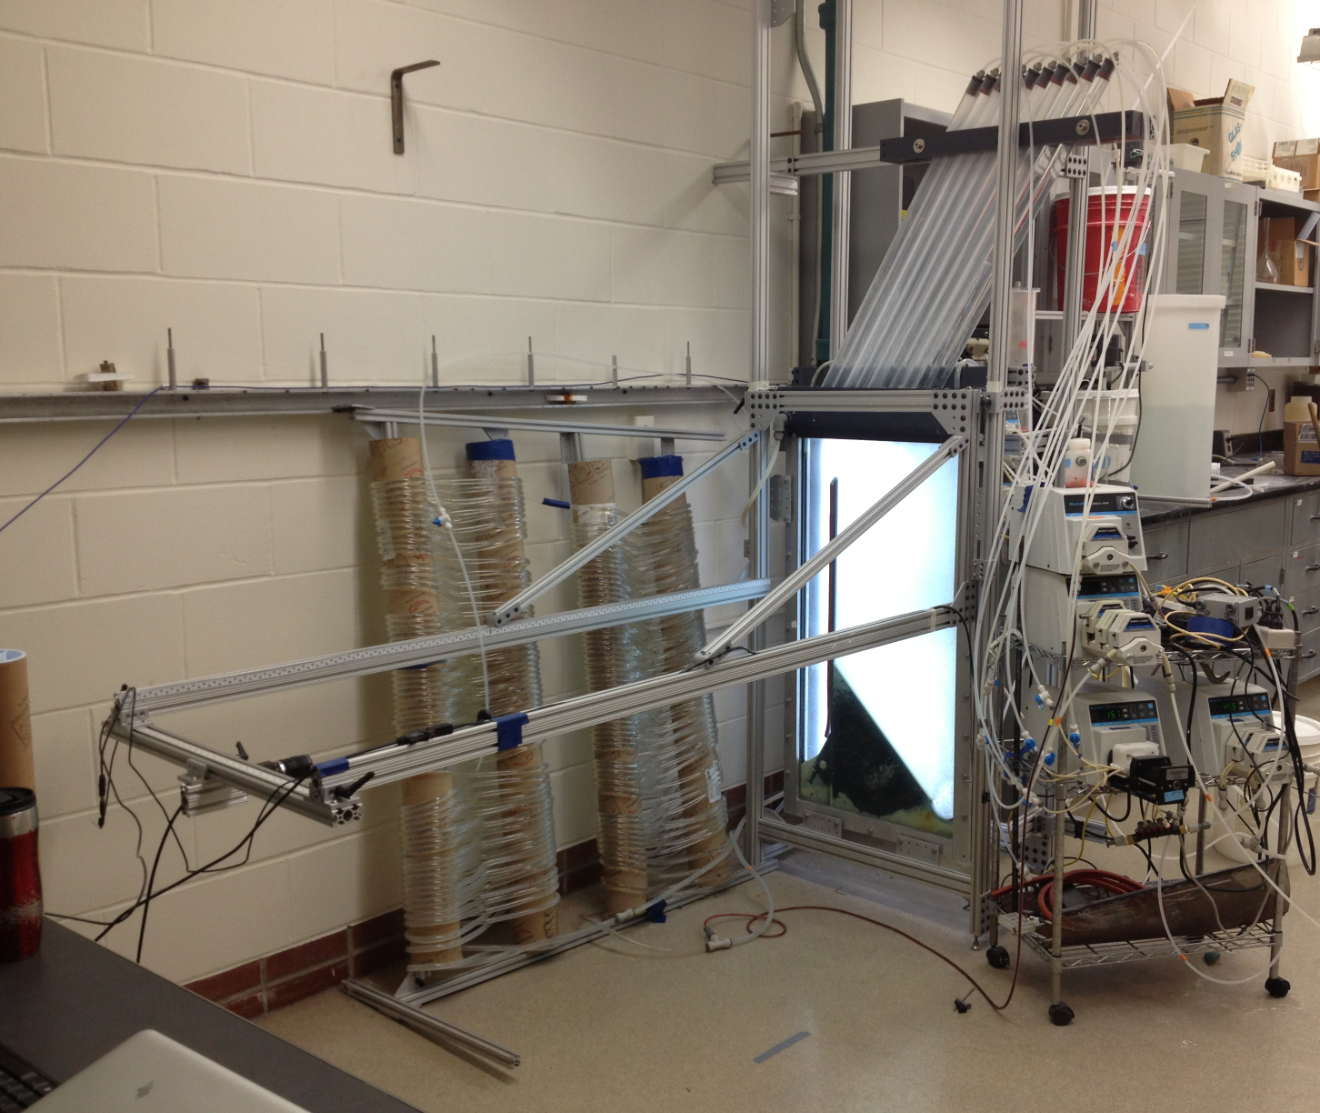
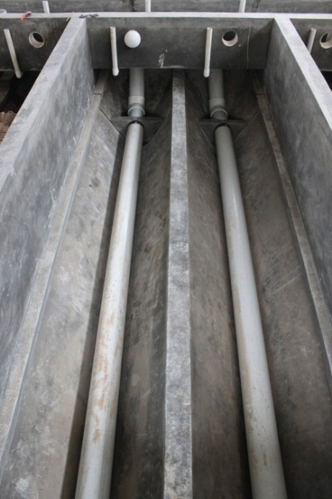
Floc Filter Research

Slide 29
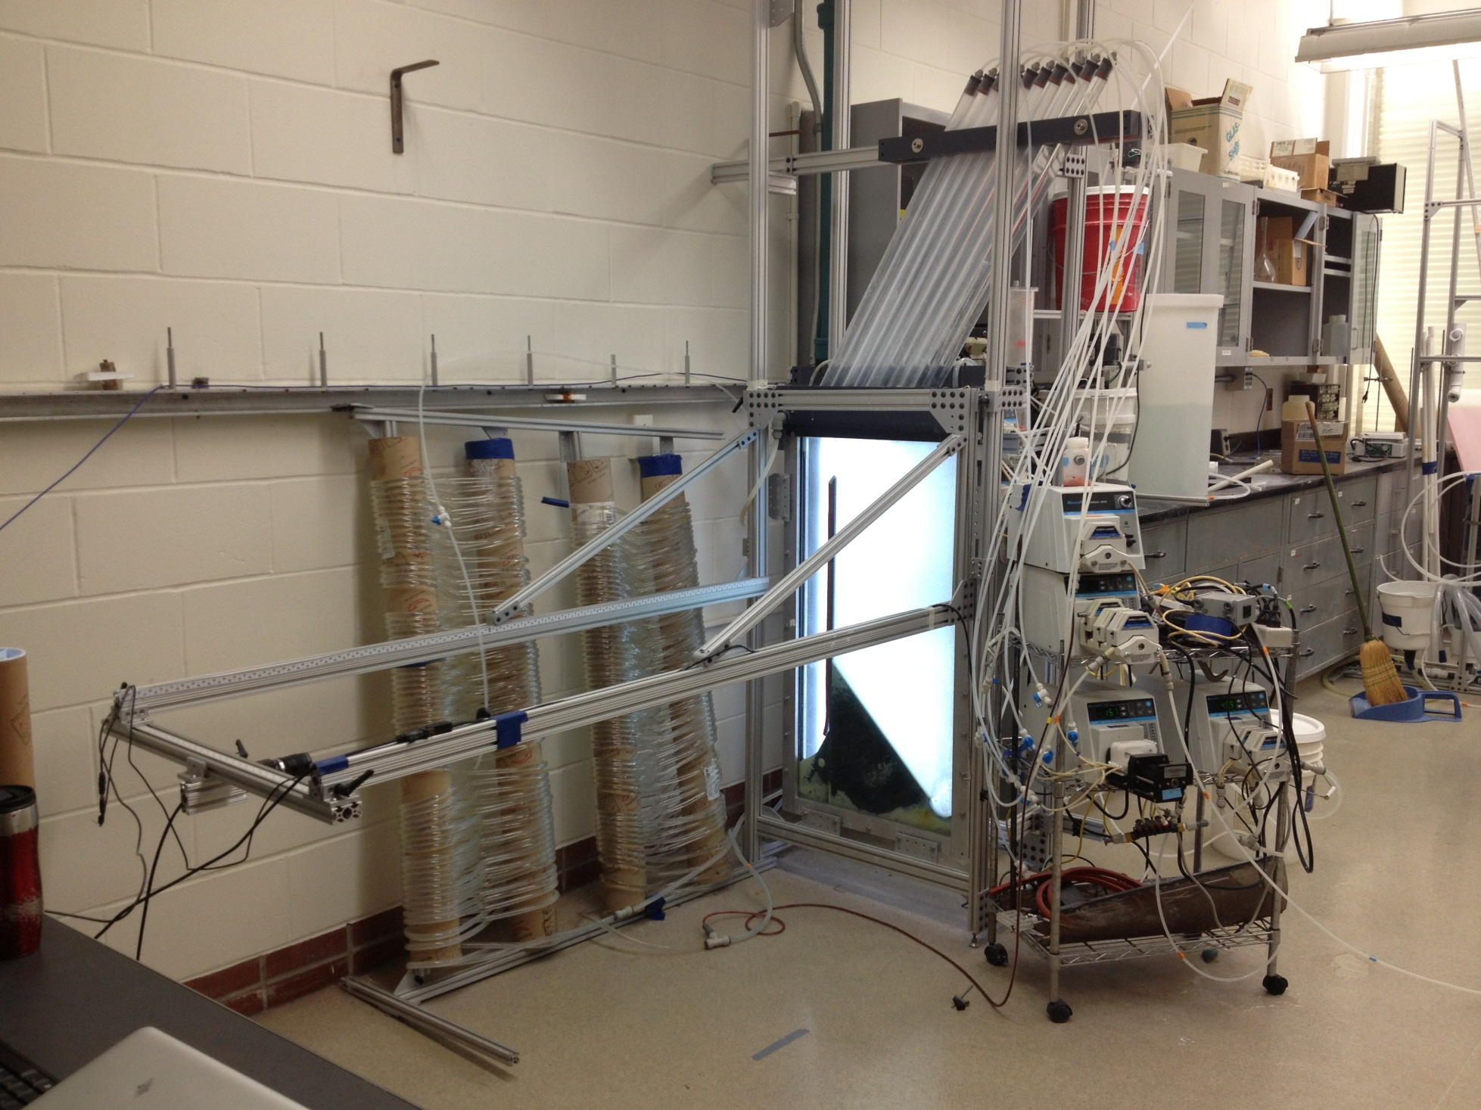
Tube Settlers
Flocculator
No sand filter….
floc filter

Slide 30

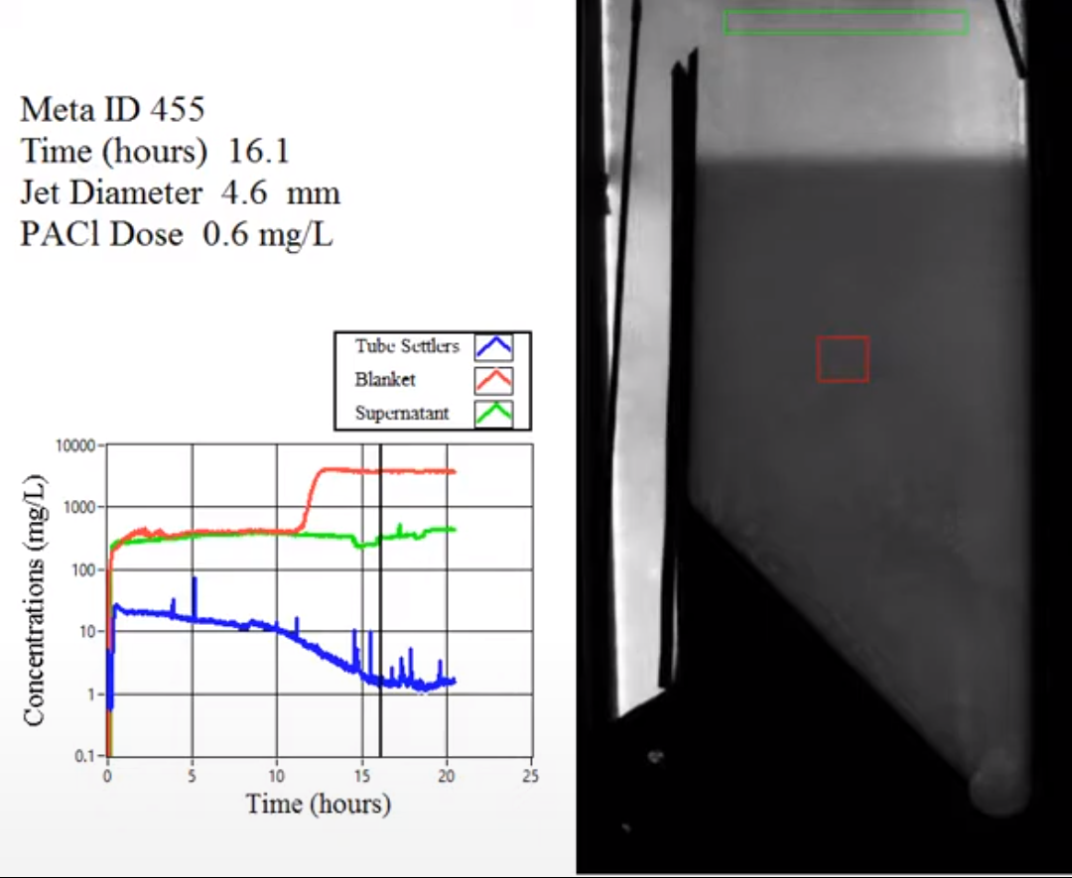
Notes:
https://www.youtube.com/watch?v=pytXC-1zWhw
<iframe width="590" height="483" src="https://www.youtube.com/embed/pytXC-1zWhw" title="YouTube video player" frameborder="0" allow="accelerometer; autoplay; clipboard-write; encrypted-media; gyroscope; picture-in-picture" allowfullscreen></iframe>
<iframe width="791" height="445" src="https://www.youtube.com/embed/pytXC-1zWhw?autoplay=1&start=285&end=360" title="YouTube video player" frameborder="0" allow="accelerometer; autoplay; clipboard-write; encrypted-media; gyroscope; picture-in-picture" allowfullscreen></iframe>
How does the floc filter remove small particles?
Are plate settlers needed after a floc filter?
What determines how fast the floc/water interface rises? 100mg/L*1mm/s = 3000 mg/L * x mm/s
Why might a floc filter reduce settled water turbidity?
How is water entering the tank?
Where do the solids eventually go?
What mechanisms could result in particle aggregation in a floc filter?

Slide 31
Floc filters are very different from flocculation
Flocculation
Floc filter
Shear flow
Particles can only attach to similar sized particles
Primary particle aggregation rate slows as number of concentration of primary particles decreases
Effluent contains many small flocs and a few NTU (or mg/L) of primary particles that haven’t been flocculated
Filtration inside flocs
Only very small particles flow into the floc filter flocs and then attach inside the floc
Full size flocculator flocs can’t attach to floc filter flocs (shear on outside of floc filter flocs is too high)
The suspension leaving the top of the floc filter contains small flocs from the flocculator as well as some primary particles

Slide 32
Floc filter Questions
How do you design for flow rate variability?
This is complicated because the concentration of the floc filter increases as the flow rate decreases and thus the jet reverser has to work harder to maintain the suspension.
We don’t yet have equations to guide this!
Notes:
What fails when the flow rate slows?

Slide 33
Floc filter Questions
How will the operator observe the floc filter? (flashlight through the plate settlers… Can we do better?)
How could we make it work better?
Waste only full flocs
Add more new flocs
Notes:
Perhaps split into teams here to brainstorm how to make the floc filter work better

Slide 34
Jet Reverser
 | Terminal Velocity
 |  | 2
 |  | 2
 |  | 2
 |  | >2
Jet reverser is key to maintaining the floc filter in suspension
Notes:
Story
Big green flocs from flocculator form blue floc filters in the plate settler
Red flocs

Slide 35
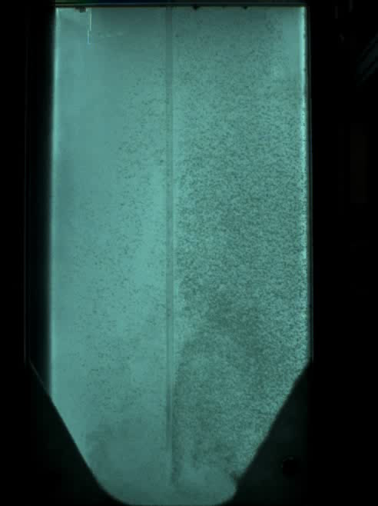
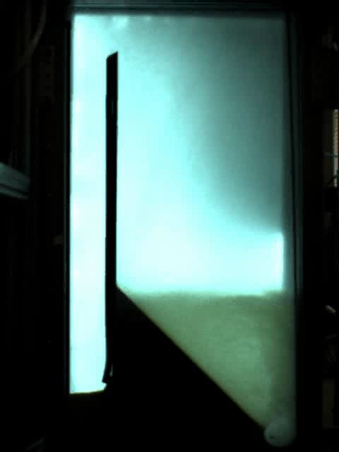
Clarifier Bottom Geometry determines if floc filter builds
Floc Hopper
Upflow velocity is 1 mm/s
Flat bottom
Jet Reverser

Slide 36
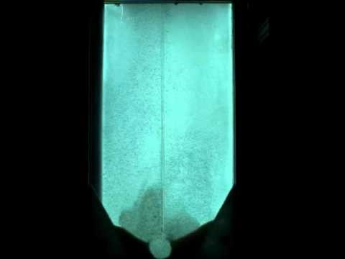
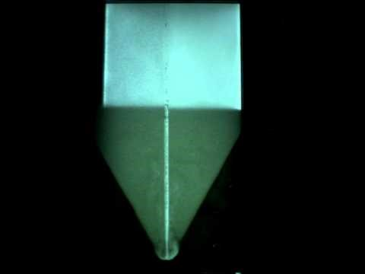
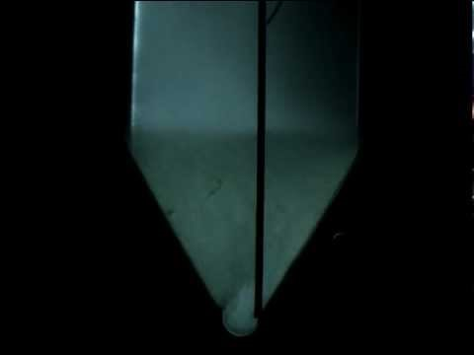
floc filter Resuspender
Flat bottom
Centered jet
Offset jet

Slide 37

floc filter Resuspender
Can a settled floc filter be resuspended? (yes, at least sometimes)
Inlet diffuser
Diffuser tubes flattened to achieve a continuous jet of water the entire length of the Floc-filter/Sed
How does this animation violate the laws of physics?
Floc pickup location
Jet reverser

Slide 38
The jet reverser creates a vertical jet that resuspends settled flocs
All surfaces must transport particles to a resuspension zone
Sludge produces gas that suspends particles
Clarifiers should have zero sludge
Notes:
May have application in other fluidized bed reactors too! No patents – you can use this new technology
<iframe width="640" height="360" src="https://www.youtube.com/embed/oHcKJD_OdfI?autoplay=1&mute=1&start=388&end=398&showinfo=0&rel=0" title="YouTube video player" frameborder="0" allow="accelerometer; autoplay; clipboard-write; encrypted-media; gyroscope; picture-in-picture" allowfullscreen></iframe>

Slide 39






The jet deflects more when it has less momentum
Failure occurs below jet velocity of 75 mm/s
Current of settled flocs
Current of settled flocs
$$θ_{1}$$
$$θ_{2}$$
Jet
Jet
3.9 mm Jet Diameter
8.9 mm Jet Diameter
$$θ_{1}$$
<
$$θ_{2}$$

Slide 40



Design of the Inlet Diffuser
If a Floc-filter/Sed has a length of 6 m, a width of 1 m, a depth of 2 m, an upflow velocity of 1 mm/s, and a diffuser center to center spacing ($B_{Diffuser}$) of 5 cm…
What is the flow rate from one diffuser? ________________________
Notes:
(50 mm)(1 m)(1 mm/s) = 50 mL/s

Slide 41



Is there a Vena Contracta?
In a vena contracta, the fluid is forced to accelerate because there is a sudden change of direction that forces the water into a smaller flow space
Here there is a gradual change in direction and the water is not being forced into a smaller space
Apply Bernoulli! Pressure is the same! Elevation is the same! Therefore velocity must be the same!
No vena contracta here
Notes:
Pressure across parallel streamlines is constant. Take ascending jet at same elevation as exit from slot. Potential energy is the same. Pressure is the same. If flow accelerated it would require the pressure to drop in the jet, but the jet is always exposed to the open tank on the inner side of the jet and thus the pressure can’t be dropping along the jet.

Slide 42


Jet velocity constraints: a min and a max
Based on shear in the jet exiting the diffusers
Very limited data showing floc blanket collapse for at low jet velocities

Slide 43







Diffuser Dimensions
View from the bottom

Slide 44
Floc Hopper
 | Terminal Velocity
 |  | 2
 |  | 2
 |  | 2
 |  | >2
Floc hopper is where excess particles accumulate and then are wasted at a high concentration
Notes:
Story
Big green flocs from flocculator form blue floc filters in the plate settler
Red flocs

Slide 45


Self-cleaning, sludge-free Floc-filter/Sed (without using electricity)
Notes:
Note that red dye can be removed by Polyaluminum chloride!

Slide 46



Floc Hopper Requirements
Weir controls the depth of the floc filter
Floc filter flow rate into the floc hopper is a function of the mass flux of particles into the sed tank
Flocs in the floc filter settle at a rate equal to the upflow velocity (1 mm/s)
The area required for consolidation could be based on max raw water turbidity and the corresponding floc filter concentration
More work needed for a model for the floc filter concentration
*ff = floc filter
Notes:
If influent concentration is 20 mg/L, and floc filter is 2000 mg/L, then what is the flow rate into the floc hopper

Slide 47



Previous state-of-the-art… SUPERPULSATOR® Clarifier
Notes:
https://www.youtube.com/watch?v=UNhygQov69Q
Why is pulsator needed?
Which end of the sed tank will have flocs rising rapidly? (two reasons)
<iframe width="640" height="360" src="https://www.youtube.com/embed/UNhygQov69Q?autoplay=1&mute=1&start=68&stop=214" title="YouTube video player" frameborder="0" allow="accelerometer; autoplay; clipboard-write; encrypted-media; gyroscope; picture-in-picture" allowfullscreen></iframe>

Slide 48

Why is there pulsing flow in a SuperPulsator?
What failed when they didn’t pulse?
What problem were they trying to solve?
Can we solve that problem a better way?
Will sludge accumulate and go anaerobic?
Notes:
Sludge slowly buries more and more of the inlet manifold system.

Slide 49

Clarification!
How do we design a tank so that particles are separated from the water?
We will begin by looking at how simple sedimentation tanks (big rectangular or cylindrical open tanks) are supposed to work
Then we will explore plate settlers

Slide 50





Horizontal Flow Clarifier
How much time is required for water to pass through the tank? _____
How far must a particle fall to reach the bottom of the tank (worst case)? _____
How fast must the particle fall?
W
θ
H
H
L
entrance
exit
Yes
Will it remove any smaller particles? ___
Settle Capture velocity: Property of the sedimentation tank. The slowest settling particle that the sedimentation tank captures reliably.
Notes:
How do I design a sed tank to capture 40 um flocs?

Slide 51
Vertical Flow Clarifier
How much time is required for water to pass through the tank? _____
How far must a particle fall relative to the fluid to not be carried out the exit? _____
How fast must the particle fall (relative to the fluid)?
exit
θ
W
L
H
H
Will any smaller particles be captured? ______________________________ ______________________________
Only if they collide and grow so they have a terminal velocity > v_{c}
entrance

Slide 52



Settle Capture Velocity Guidelines
Based on tube settlers
0.12 – 0.36 mm/s
Based on Horizontal flow tanks
0.24 to 0.72 mm/s
AguaClara adopted 0.12 mm/s in an effort to reduce effluent turbidity as much as possible because AguaClara wasn’t using filters
Now we have the connection between temperature, velocity gradient in the flocculator and jet reverser, and the plate settler capture velocity
https://www.brentwoodindustries.com/water-wastewater-products/tube-settlers/
Surface Water Treatment for Communities in Developing Countries. Christopher R. Schulz,Daniel A. Okun

Slide 53
Plate Settler
 | Terminal Velocity
 |  | 2
 |  | 2
 |  | 2
 |  | >2
Plate settlers capture flocs that settle faster than a velocity that we will calculate next!
Plate settlers flocculate flocs and return them to the floc filter!
Notes:
Story
Big green flocs from flocculator form blue floc filters in the plate settler
Red flocs

Slide 54
Plate Settlers Capture Particles that settle faster than the plate settler capture velocity
Notes:
How do we know charge neutralization doesn’t explain flocculation
Floc aggregation begins even with very small dosages of coagulant long before the surface charge is neutralized
No transition in flocculation performance as the coagulant dose is gradually varied over a very wide range
No evidence of charge reversal causing deterioration in performance
A single physics-based model describes the full range of flocculation from low to high coagulant dosages
Coagulant nanoparticles are so large that they easily extend through the double layer and hence can directly bridge between two negatively charged particles
No one has been able to develop equations describing the role of charge neutralization
Confusion in the literature about whether WTPs use charge neutralization or sweep floc. No quantification of how you would know which hypothesized mechanism is operative

Slide 55
3 Requirements for Plate Settler Success
The floc must be able to settle to the surface of a plate or tube settler
Settle capture velocity
It must NOT slide or roll up the incline
Slide capture velocity
It must roll down the plate and combine with other flocs to increase its terminal velocity so it can fall back into the floc filter (and become a contributing member of the floc filter)

Slide 56


Critical path for capture
Critical path for capture
L
H
S
α
α

Slide 57







Settle Capture Velocity for Plate (and Tube) Settlers
Path for critical particle?
How far must particle settle to reach lower plate?
H_{c}
L
H
S
What is total vertical distance that particle will travel?
α
α
What is net vertical velocity?
Particle velocity

Slide 58





Equate times to obtain the capture velocity
Time to travel distance H_{c}
=
Time to travel distance H
This ratio represents the plan view area reduction factor!
Notes:
The ratio of the upflow velocity to the capture velocity is really a measure of the reduction in tank area that is possible from using plate settlers. It is easy to get a factor of 10 reduction.

Slide 59




Clarifier vertical velocity components
Outlet manifold
Plate Settlers
Floc hopper
Floc filter
Inlet manifold
Notes:
This was tested at multiple plants and is much better than the manifolds that were simple pipes with a row of holes!

Slide 60





Plate Settler Design (AguaClara approach)
Upflow velocity (determines size of tanks) (1 mm/s)
If floc filter is a goal then needs to be approximately 1 mm/s
Capture velocity (0.12 mm/s)
Must capture the large flocs produced by the flocculator (and jet reverser)
Plate angle (60 deg)
self cleaning (60 deg works well)
Spacing (2.5 cm)
Clogging (not a problem at 2.5 cm)
floc roll up: Will the floc slide down? (next topic in the notes!)
Length of the plate settlers
will be the parameter that we calculate

Slide 61
Floc Filter, Plate Settler, Floc Hopper
Effluent manifold
Plate Settlers
 | Terminal Velocity
 |  | 2
 |  | 2
 |  | 2
 |  | >2
Floc Filter
Floc Hopper
Inlet (from flocculator)
Notes:
Story
Big green flocs from flocculator form blue floc filters in the plate settler
Red flocs

Slide 62
Reflections on learning
How do you remember what happens in lecture?
What do you do to be actively engaged?

Slide 63
Plate Settler Spacing Constraints: Floc Rollup
Why do we care? – What is the connection to sustainability?
Why not use the standard design?

Slide 64


Floc Roll Up Solution Scheme: Another failure mode
Find the velocity gradient next to the plate
Find the fluid velocity at the center of the floc
Find the terminal velocity of the floc down the plate (for the case of zero velocity fluid)
Set those two velocities equal for the critical case of no movement
α
gsin(α)
g
α
α

Slide 65



Minimum Plate Settler Spacing
Assume fractal dimension of 2
This failure mode will show up only with very low density core particles and cold water
Given that AguaClara uses a lower upflow velocity, , than many plate settler designs it is okay to use more closely spaced plates, S.
Notes:
plateAN = 60 * u.deg
vz = 1.2 * u.mm/u.s

Slide 66



Plate Settler Spacing effects
Plate settler spacing has a strong influence on sedimentation tank depth
Diminishing effect for small S
Maintaining spacing becomes more challenging for small S because the plates are quite flexible
Too small an S will fail!
5 cm
2.5 cm
1 cm

Slide 67
Plate Settler Conclusions…
Designed to capture flocs with sedimentation velocities greater than the settle capture velocity
Spacing determines the ability of the flocs to roll down the incline

Slide 68
Plate Settler Confusions…
We need a basis for choosing a settle capture velocity based on overall plant performance*
Smaller spacings have diminishing returns in terms of sedimentation tank depth. So for now we are using 2.5 cm.
Flocs made from natural organic matter may be less dense, more prone to floc rollup, and require larger spacing between plate settlers
* Predictive performance model for hydraulic flocculator design with polyaluminum chloride and aluminum sulfate coagulants. Karen A. Swetland, Monroe l. Weber-Shirk, and Leonard W. Lion. Journal of Environmental Engineering, submitted (2012)

Slide 69
Floc Volcanoes: An example of a failure mode in sedimentation tanks
Intermittent floc volcanoes in the Floc-filter/Seds at San Nicolas
Flocs rise preferentially on one side of the sed tanks
Raw water turbidity = 4 NTU
PACl dose = 3.5 mg/L
Settled water turbidity varies between 0.5 and 4 NTU
Brainstorm! What is happening? Why does our plant do so poorly?
Notes:
What do you know?
What could cause what is observed?
Which of those causes is consistent with observations?

Slide 70

Settled Turbidity at San Nicolas
Raw water
Turbidity (NTU)
Settled water

Slide 71

Plate Settler Problems: Temperature Gradients
Warmer water is less dense
Warm water rises
Cold water drops
Performance drops
Need a solution!
Not sure WHY
Could we further reduce residence time in floc filter and plate settlers so that density gradients are less significant?

Slide 72
Sed Tank Inlet design Opportunities as of 2022
Floc break up is likely a constraint for delivery of water to the Floc-filter/plate settlers.
Flow distribution and the ability to resuspend a settled floc filter are likely the most important constraints
For reasonable flow distribution, the inlet manifold has to be larger in diameter if we reduce the jet velocity to avoid breaking up flocs. We need an invention that will enable us to use smaller diameter inlet manifolds to keep costs down!

Slide 73

Design Review
Comparing designs
Pan-American Health Organization (CEPIS)
Superpulsator® (we already looked at this one)
AguaClara
What is good?
What can be improved?
What could (or did) fail?

Slide 74

Santa Rosa de Copan: CEPIS Plant Tour
Notes:
https://www.youtube.com/watch?v=aLaCuq9PK7s
<iframe width="640" height="360" src="https://www.youtube.com/embed/aLaCuq9PK7s?autoplay=1&mute=1" title="YouTube video player" frameborder="0" allow="accelerometer; autoplay; clipboard-write; encrypted-media; gyroscope; picture-in-picture" allowfullscreen></iframe>

Slide 75

CEPIS/OPS designs – Vertical Flow
Critique this design
Sludge will accumulate on the flat tank bottom
How are plate settlers suspended?
Inaccessible channels
Access to bottom of tank?
Notes:
CAPÍTULO 4
DECANTADORES LAMINARES

Slide 76

CEPIS Sed
Plate settlers and outlet manifolds
Outlet Manifolds must be perfectly level using this system (orifice elevation sets water elevation!)
Submerged launders are easier to build with no concern if they aren’t level
Channels for inlet and outlet

Slide 77



AguaClara Evolution
Ojojona - Vertical Flow Sedimentation (2 m)
Tamara and Marcala - sloped bottoms of the tanks (2 m)
4 Comunidades - Inlet manifold below the sloped bottoms (1.55 m) and no elevated platforms
Agalteca – Inlet manifold pipe with orifices

Slide 78

Cuatro Comunidades
Inlet channel
Vertical chimney

Slide 79


Cuatro Comunidades Sludge
Notes:
Mud in the bottom of the sed tank in 4 Com in May during the first cleaning. Note as Monroe inferred that there doesn’t seem to be too much depth of accumulation in the middle of the tank; there seems to be more behind the panels that form the triangle. Note that the mud behind the panels is dark underneath (and reeks) meaning that there is some kind of biological decay occurring. That mud is very tough and doesn’t come out with just wash water, as you see in the next picture, a shovel is necessary. I think some kind of tool will always be needed to clean any plant, but the easier the mud can come out the better off for operation and water quality.

Slide 80


Brainstorm
Why is this problem occurring?
How would you fix this problem?
What concepts might be important in obtaining a solution?
What are some of the other constraints that must be considered?

Slide 81

Floc escape at Agalteca (2009)
“For many plants it is common for the water in the middle of the tank to be clear, yet have a lot of floc rise at the end of the tank.”
“indicates density flow”
“Block off the last 10 to 20 ft…”
See page 185 of Integrated Design and Operation of Water Treatment Facilities by Kawamura

Slide 82

Large scale circulation and poor performance is common in sedimentation tanks
This is an inertia problem, not a density problem!

Slide 83

No floc filter in this design because of flat bottom section that covers the drain

Slide 84


Inlet Manifold Improvements at Tamara

Slide 85

Diffusers that Eliminate Circulation and Keep the Floc Filter in Suspension
Outlet manifold
Plate Settlers
Floc hopper
Floc filter
Inlet manifold
Notes:
This was tested at multiple plants and is much better than the manifolds that were simple pipes with a row of holes!

Slide 86

Floc hopper
Sludge drain
Floc hopper
Floc weir

Slide 87



Moroceli – Fall 2014
Port for outlet manifold
Floc hopper
Floc weir
Port for inlet manifold

Slide 88


Holes drilled to ID of mold
Mold to reduce the pipe diameter

Slide 89


Pipe with reduced diameter end

Slide 90


Inlet Manifold
Diffusers
Holes to drain beneath jet reverser were eliminated beginning in 2015.
Jet reverser

Slide 91


Diffusers direct a jet of water into the jet reverser
Plate settlers
Inlet Manifold
Diffusers
Floc pickup location
Jet reverser

Slide 92


Slide 93

Clarifier inlet and outlet
Outlet weir
Water surface
Outlet manifold
Collector channel
Outlet channel
Floc filter top surface
Flocculated water dump channel
Inlet channel
Inlet manifold
diffusers
Jet reverser
Clarifier bay drain

Slide 94

Outlet channel
Inlet channel
Plate settlers
Floc Hopper
Floc filter

Slide 95

Steps to take an Floc-filter/Sed offline and then return it to service

Slide 96

Block inlet water

Slide 97

Block outlet manifold and drain tank

Slide 98

Remove outlet Manifold

Slide 99

Remove plate settlers

Slide 100
Replace plate settlers

Slide 101
Replace outlet manifold
How shall we fill this tank?

Slide 102
Fill the tank through the outlet manifold!

Slide 103
Remove the inlet pipe stub to return the tank to service

Slide 104

Questions
Why do we use plate settlers?
What is the failure mechanism for plate settlers for small spacing?
How do flocs end up in the floc filter?
How fast does the floc filter settle into a pile of sludge when the flow is stopped?
Notes:
6m / 0.17m/s
4mm/s
Entrance channel design is now governed by flow distribution constraint. Don’t drop the flocs, distribute the water between sed tanks.

Slide 105
Floc-filter/Sed Conclusions
3 processes in one tank: floc filter, sedimentation, consolidation
Eliminate the need for mechanized sludge removal by using hydraulic sludge removal
Provide the operator with options for dumping poorly flocculated or poorly clarified water

Slide 106
Floc-filter/Sed Conclusions
Plate settlers make it possible to significantly reduce Floc-filter/Sed area
Reduced plate spacing reduces depth of Floc-filter/Sed
Floc filters improve performance and provide a method to remove sludge
Flow distribution is VERY important
Hydraulic residence time of 24 minutes is sufficient for efficient clarification

Slide 107
Invention Opportunities
Increase the concentration of flocs that can act as filters in the floc filter
Floc recycle
Selective wasting of full flocs
Decrease the required diameter of the inlet manifold

Slide 108

Coagulant dose setting based on rapid settling of flocculated water
Particle counter
Plant operators will set a target particle count
If particle count is too high the coagulant dose will be increased
Goal: obtain a faster indication of whether the coagulant dose is correct and use the AguaClara flocculation model to propose a change in the dose
Submerged tube settler that will remove flocs
Flocculator

Slide 109
Outlet manifold
Plate settlers
Floc weir
Floc filter
Floc hopper
Inlet manifold
Diffuser
Jet reverser
Notes:
Story
Big green flocs from flocculator form blue floc filters in the plate settler
Red flocs

